Slide 1

June 13, 2018
Wifi: 1393Conference
Password: kayla1393

Slide 2

Welcome
Announcements:
LIHC Meeting August 9 is
CANCELLED
www.lihealthcollab.org

Slide 3
Upcoming Events
BusinessLIHC Bingo
Public Health Program Evaluation Webinar
North Shore Animal League Walk and Wag
www.lihealthcollab.org

Slide 4


CBO Engagement in VBP:
An Opportunity to Meet
Long Island’s Needs
Emily Rogan
Project Manager, CBO Planning Grant

Slide 5
Long Island’s regional nonprofit umbrella organization for health and human service providers.
ESTABLISHED IN 1947
MISSION
HWCLI serves the interests of poor and vulnerable people on Long Island by convening, representing, and supporting the organizations that serve them; and through:
Illuminating the issues that critically impact them
Organizing community and regional responses to their needs
Advocacy, research, policy analysis
Providing services, information and education

Slide 6
Why is this work critical?
“Fully addressing social determinants of health requires a shift in power that enables marginalized communities to co-design their own healthcare solutions. Unfortunately, health insurers, while willing to alter payment models and entertain some changes in what they will pay for, have yet to grasp the more fundamental nature of the need for system change and community empowerment inherent in the idea that health, ultimately, is about much, much more than health care.”
American Journal of Managed Care, 2/15/18

Slide 7
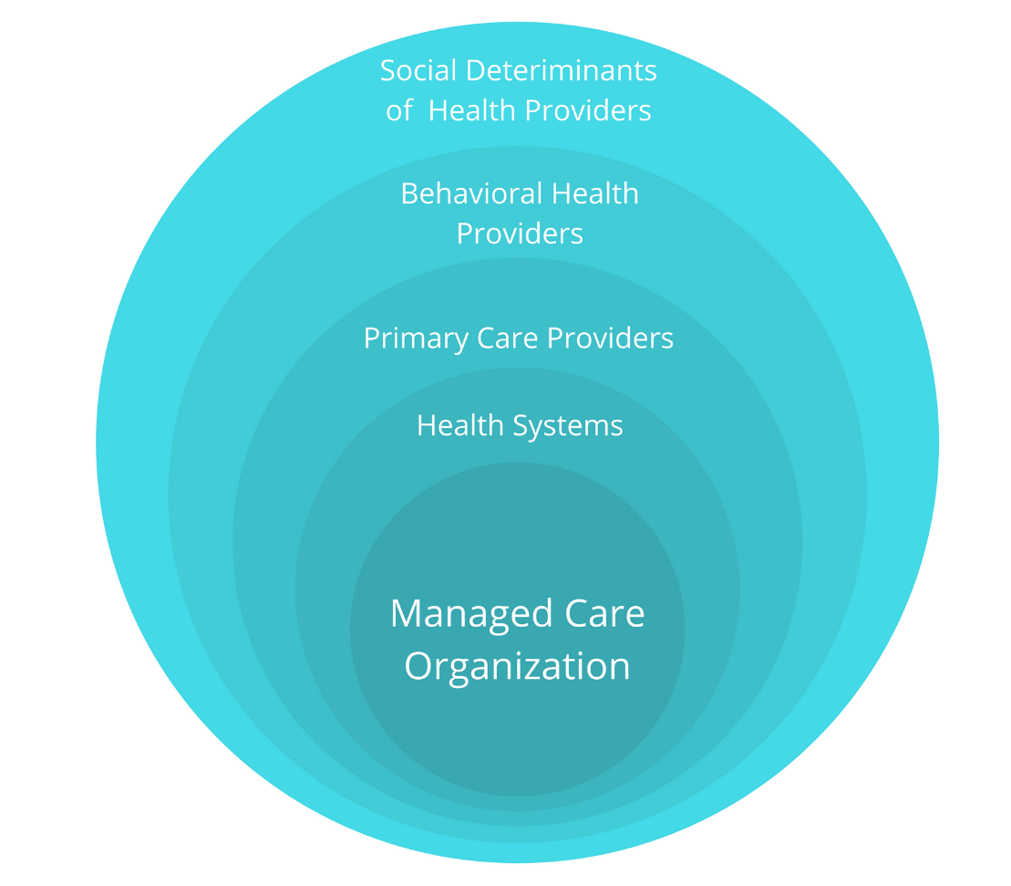
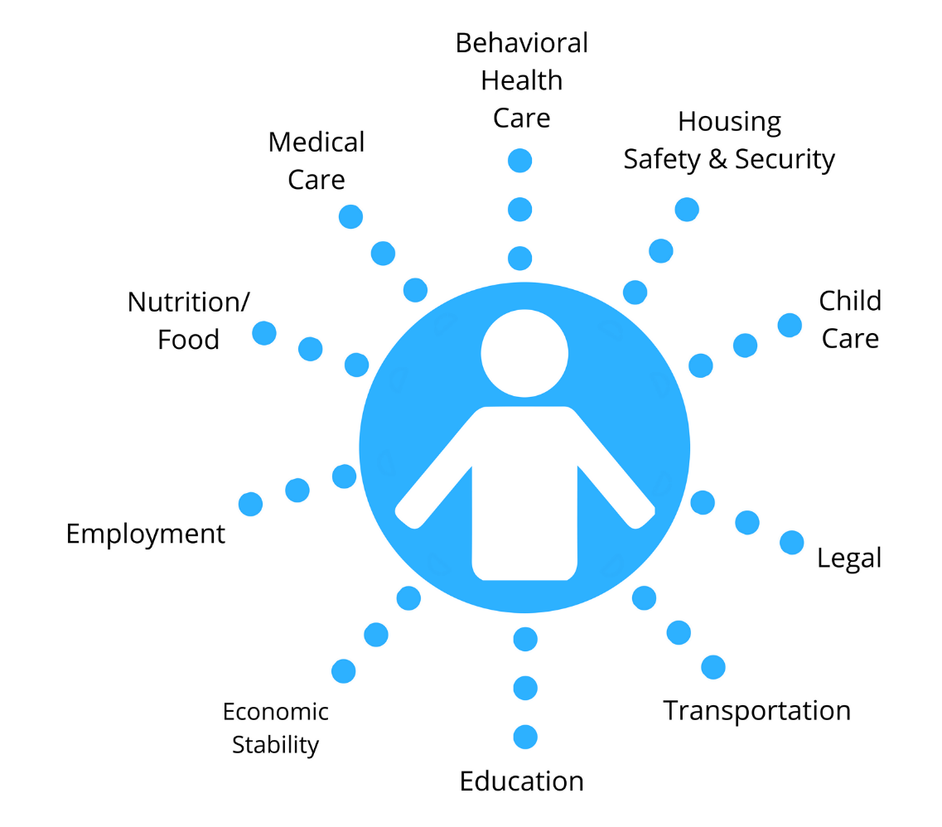
Why a health equity focus?
Value Based Payment Arrangement
Client Focused Service Delivery Model

Slide 8

Why a Health Equity Alliance?
By creating a system where one does not exist, we can better help underserved communities have equitable access to health & human services. Together, we can address inequities to build and sustain healthier Long Island communities.

Slide 9

Consider This

Slide 10






Steering Committee Members
Health & Welfare Council of Long Island
CARECEN-NY
Child Care Council of Nassau
Choice for All
LI Against Domestic Violence
LI Coalition for the Homeless

Slide 11
HEALI Members
70 Long Island CBOs (Alliance)
46 Long Island CBOs (Consortium)
  – 501(c)3
  – Non-Medicaid billing
  – Annual operating budgets ≤ $5 million
  – Experience providing community-based services that address SDH

Slide 12
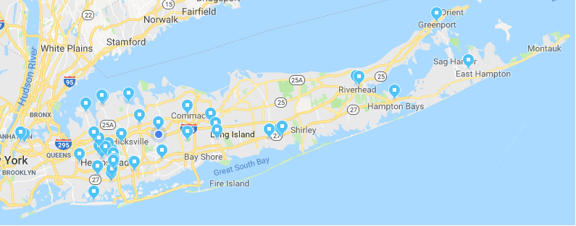
Geographic Diversity
HEALI serves clients from Elmont to Montauk

Slide 13
Wide Range of Service Areas

Slide 14
Populations Served
Hispanics
Haitians
Immigrants
Undocumented
Youth/At risk youth
Children
Families
Child Care Providers
Underemployed
Low income citizens
Health care providers
Senior Citizens
Homeless/Formerly homeless
Active and illicit drug users
LGBTQ
People with Disabilities
People with chronic illness
People living with HIV/AIDS
Formally incarcerated individuals
Survivors of domestic violence, sex workers, women impacted by trauma

Slide 15
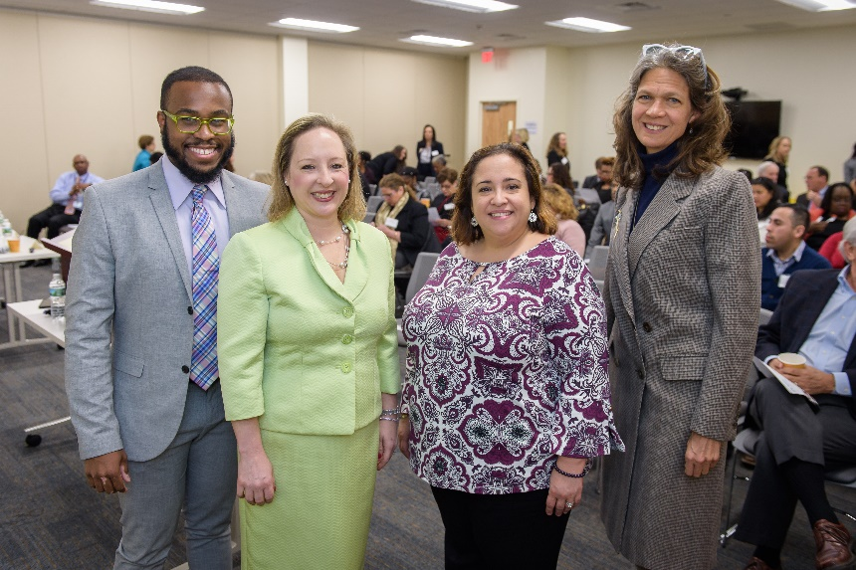
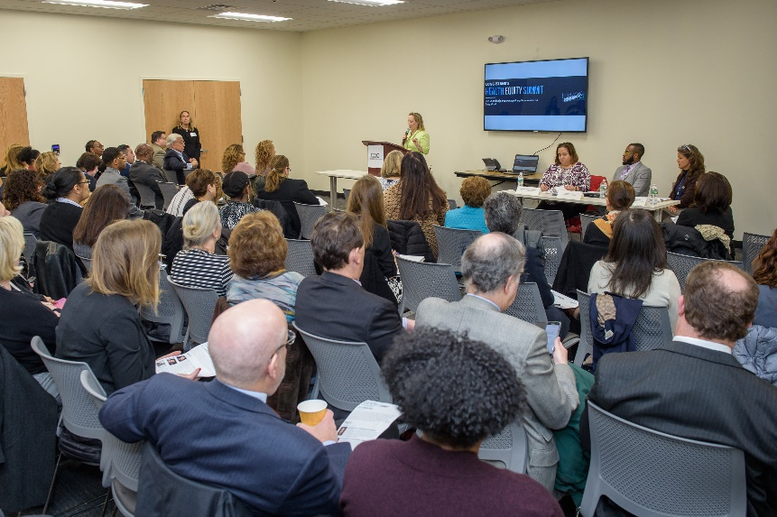
Work To Date
Health Equity Summit
Collaborative CBO Brainstorming Session
70 CBOs engaged
Convened steering committee representing multiple SDH
Engaged PPS & MCOs in robust dialogue about this work and the potential for authentic partnerships

Slide 16
HEALI members asked to rate importance of (1-5 Likert Scale)
A centralized database of services provided by HEALI partners: 4.33
Clients to be a part of the development process of HEALI: 4.33
A unified system that tracks and refers clients as they move across the social determinants of health: 4.18
HEALI developing a clearing house or hub to coordinate services and to support clients: 4.12
HEALI partners having a standardized screening, intake, and referral process to serve clients: 3.67

Slide 17
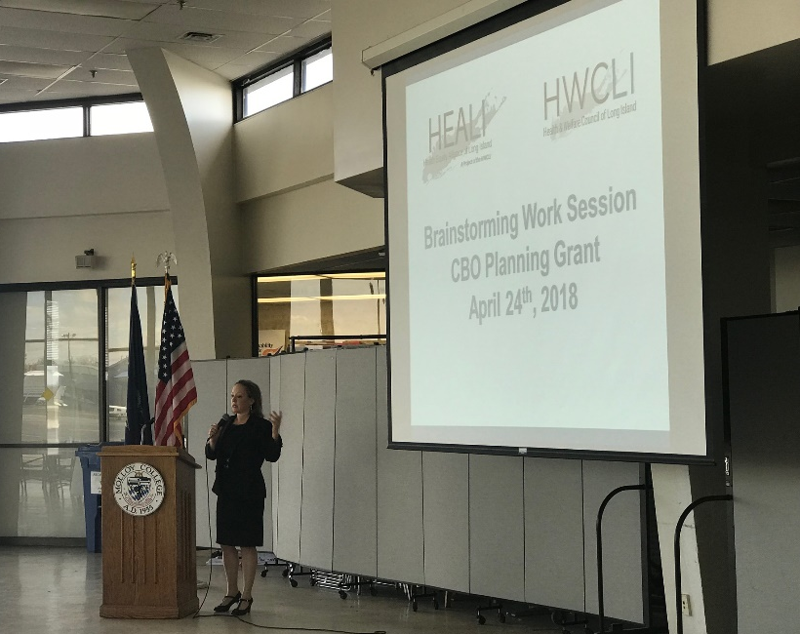
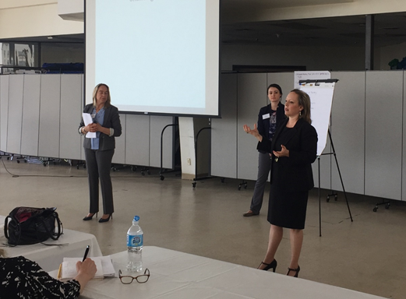
Developing Work Groups
Focused strategic planning to improve Long Island’s service delivery system
Informative learning collaboratives
Educational webinars about VBP
Innovative, state-of-the-art portal

Slide 18
Questions?
Emily Rogan
erogan@hwcli.com
516-505-4434

Slide 19

Networking & Stretch Break
www.lihealthcollab.org

Slide 20
Recap
Legislative Briefing with Senator Kemp Hannan
Walk Bike Nassau
www.lihealthcollab.org

Slide 21
Walk Bike Nassau
Drunk Goggles Walk

Slide 22
Walk Bike Nassau- Drunk Goggles Walk

Slide 23
NYS Prevention Agenda
Updates
Next Steps
www.lihealthcollab.org

Slide 24
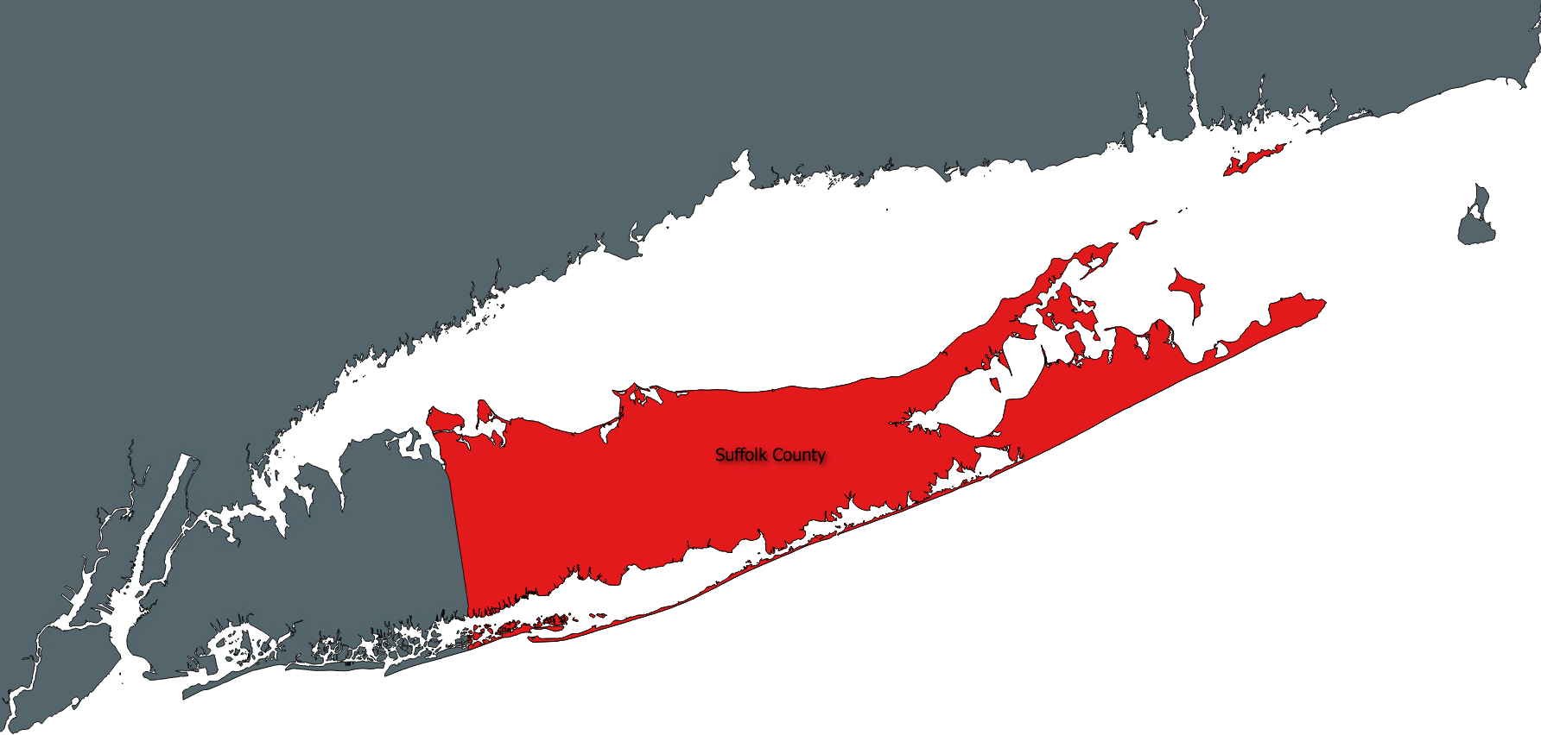
Suffolk Care Collaborative Announcements
Community Engagement Team
Sofia Gondal, MA
Community Engagement Liaison
Suffolk Care Collaborative

Slide 25

SCC Community Engagement webpage
SCC Community Engagement Webpage:
www.suffolkcare.org/community
Health Education Materials
LIHC Community Calendar
Bulletin Board
Health Resources
HITE Resource Directory

Slide 26
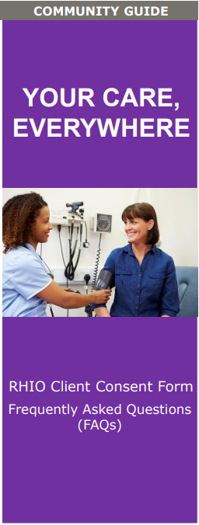
Your care, everywhere brochure
Brochures are available to educate the community about Regional Health Information Organizations (RHIOs) and how to complete the RHIO Client Consent Process.
Created in collaboration with the SCC Cultural Competency and Health Literacy IT Subgroup and partners.
The brochure was reviewed and endorsed by the SCC Cultural Competency and Health Literacy Advisory Workgroup.
To receive the brochure via email or for any questions,
please contact:
Lyndsey Clark, MS
Community Engagement Liaison
631-638-1779
lyndsey.clark@stonybrookmedicine.edu
Notes:
Another resource the SCC has available is the Your Care, Everywhere:
RHIO Client Consent Form FAQs brochure.
The brochure was created to fulfill a milestone for SCC’s IT Taskforce to develop a handout to educate the community about Regional Health Information Organizations (RHIOs) and how to complete the RHIO Client Consent Process.
Since Spring 2017, SCC Cultural Competency and Health Literacy IT Subgroup have collaborated on this effort together with the support of SCC’s IT Taskforce and RHIO partners NYCIG, Healthix, and Healthlink NY.
Furthermore, the brochure was reviewed and endorsed by the SCC Cultural Competency and Health Literacy Advisory Workgroup to ensure the content meets nationally recognized cultural and linguistic standards.
For more information about the brochure and to receive an electronic version to share with your patients/clients, please contact Lyndsey Clark, MS, Community Engagement Liaison, 631-638-1779.

Slide 27
Project Advisory Committee Meeting
Quarterly Project Advisory Committee (PAC) Meeting
To receive the registration email, please contact:
Stephanie L. Burke, MS, MHA, CHES
Administrative Manager, Community Engagement
631-638-1768
stephanie.burke5@stonybrookmedicine.edu
Date: | Tomorrow, June 14, 2018
Time: | 8:30 am – 11:30 am
Location: | Hyatt Regency Long Island 1717 Motor Parkway Hauppauge, NY 11788

Slide 28
CBO Value Based Payment
Survey reminder
SCC seeks to better understand and determine how to support our CBOs as health care increasingly moves toward Value Based Payment models.
Accepting survey responses until June 30th
To receive the survey via email or for any questions, please contact:
Stephanie L. Burke, MS, MHA, CHES
Administrative Manager, Community Engagement
631-638-1768
stephanie.burke5@stonybrookmedicine.edu
The SCC thanks you in advance for your participation.
Notes:
CBO VBP Survey Reminder
Finally, I have a quick reminder regarding our CBO Value Based Payment Survey.
All of our CBO partners should have received this 15 min survey, however if you did not please contact my colleague Stephanie Burke.
Your valued feedback/insight will help guide SCC’s next steps in understanding and determining how best to support our CBO partners in the transition to Value Based Payment models.
We are collecting survey responses until Saturday, June 30th.
VBP Presentation
Also, this coming Tuesday, June 19th 11:30 am – 12:30 pm SCC will host a live/interactive presentation of Value Based Payment 101 & 102; similar to the static presentation hosted on our Learning Center.
SCC’s Director of Business Operations, Neil Shah, will provide an overview of Value Based Payment contracting models as well as understanding of risk sharing arrangements, performance measurement and data analytics under these payment models.
Survey responders and fellow partners are welcome/encouraged to attend in-person or via Skype conference to learn more and have the opportunity to ask questions.
For more meeting details, please contact CET.

Slide 29
Long Island Health Collaborative
June 13, 2018

Slide 30
Ongoing Efforts to Support Enhanced Care
Workshops, trainings and education that are ongoing and offered on our web as well as in-person
Accessible and updated website with resources and trainings for providers www.nqpps.org
DSRIP awarded dollars used for Innovation and Performance Funds to drive better care, and improving the health of populations
Use of data analytics and performance improvement to drive strategic opportunities to meet care gaps

Slide 31
Current Trainings* Offered
NQP’s Veterans Conference:
  Date: Tuesday, June 15
  Time: Noon – 2:00pm
  Location: Nassau University Medical Center (Amphitheater, 1st Floor), 2201 Hempstead Turnpike, East Meadow, NY 11554.
Motivational Interviewing:
  Date: Monday, June 18
  Time: 9:30 am – 4:30pm
  Location: The DeMatteis Center, 101 Northern Blvd, 1st Floor – Conference Room 2, Greenvale, NY 11548.
Or….
  Date: Monday, July 16
  Time: 9:30 am – 4:30pm
  Location: The DeMatteis Center, 101 Northern Blvd, 1st Floor – Conference Room 2, Greenvale, NY 11548.
*Can sign up on NQP website to subscribe to monthly newsletters and announcements

Slide 32
Trainings cont’d
Addressing Social Determinants of Health (Housing):
  Date: Thursday, June 21
  Time: Noon – 1:00 pm
  Location: Webinar
Or….
  Date: Wednesday, July 18
  Time: Noon – 1:00 pm
  Location: Webinar
Health Literacy:
  Date: Friday, July 13
  Time: 9:00 am – Noon
  Location: 600 Community Drive, Manhasset, NY 11030, 4th Floor – Training Room.

Slide 33
Trainings cont’d
Behavioral Health Strategies for Post-Acute Care, Physical assessment and Sepsis:
  Date: Monday, July 23
  Time: 8:00 am – 4:00 pm
  Location: Northwell Health, 145 Community Drive (Conference Room #3), Manhasset, NY 11030.
Or….
  Date: Wednesday, August 1
  Time: 8:30 am – 4:30 pm
  Location: Angello Alumni House at Adelphi University, 154 Cambridge avenue, Garden City, NY 11530.
Or….
  Date: Thursday, August 2
  Time: 8:30 am – 4:30 pm
  Location: Northwell Health, 145 Community Drive (Conference Room #3), Manhasset, NY 11030.

Slide 34
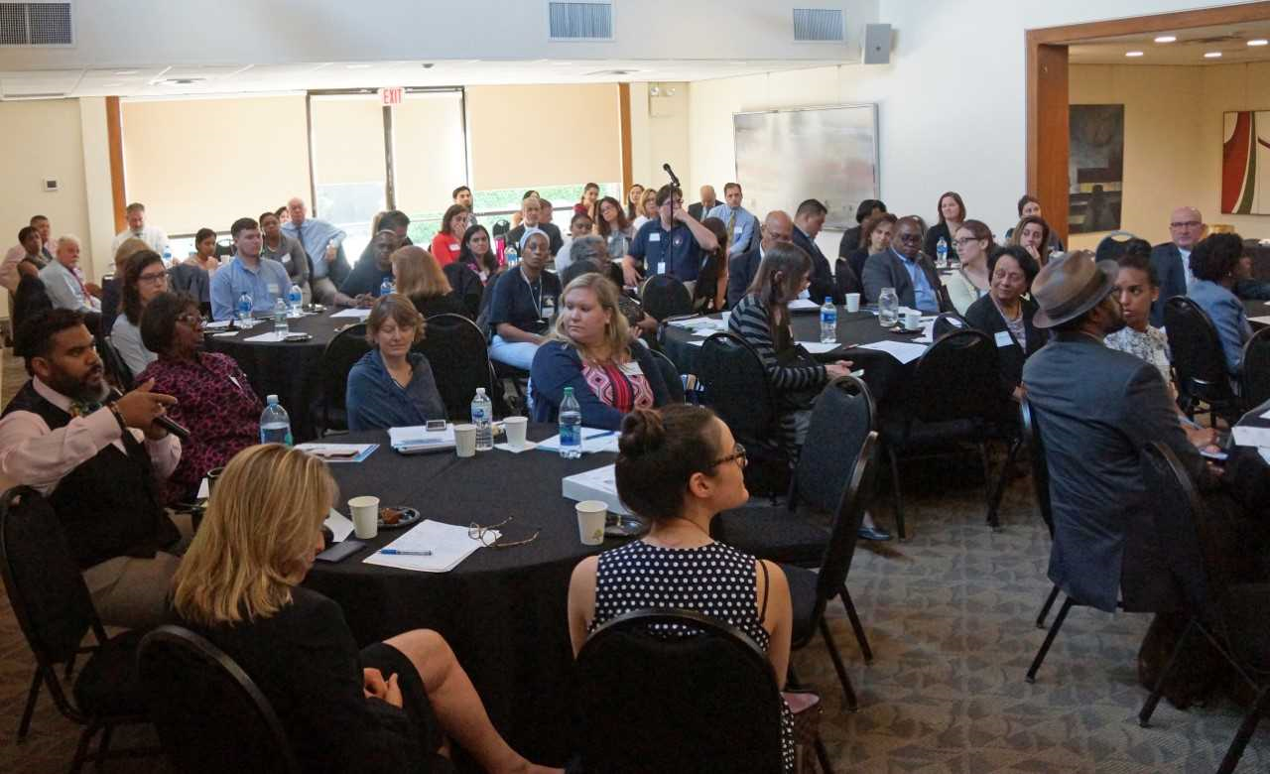
CBO Innovation Fund
Tier 1 CBO Conference Update
Health Forums
Community Innovation Fund (Phase 2)
Contact:
Bryan Valentin, BValentin@nqpps.org

Slide 35
Behavioral Health Performance Fund and Engaged Organizations
2. Cornerstone
3. Federation of Organizations
1. Catholic Charities Neighborhood Services
4. Melillo Center
5. Mental Health association of Nassau County
6. New Horizon Counseling Center
7. South Shore Association for Independent Living (Sail)
8. WellLife Network (PSCH, Inc.)
Created to contract directly with community based behavioral health providers.
Utilizing a model based off of the CBO Innovation Fund
NQP engaged with 8 community based BH providers to take direct action related to seven high value behavioral health metrics.
Contact:
Alyse Larue, ALaRue@nqpps.org

Slide 36

High Value Behavioral Health Metrics
Follow Up after Hospitalization 7 days
Follow Up after Hospitalization 30 days
Preventable ED Visits (BH)
Diabetes Monitoring and Schizophrenia
Cardiovascular Monitoring and Schizophrenia
Antidepressant Medication Adherence
Antidepressant Medication Adherence

Slide 37
NQP Website
http://www.nqpps.org/
Project Information
Project Resources
News & Events
Career
HWApps Training Portal

Slide 38
CHNA Prep Work Group
Last call for members to join, please email Katie Feerick at kfeerick@nshc.org by June 22
Looking to hold first meeting beginning of July to establish focus/themes of discussions to inform RFP for Focus Group portion
Focus Groups will be held Q1 2019
www.lihealthcollab.org

Slide 39
Feedback + Adjournment
Next meeting, October 10
To register, visit
lihcjune2018.eventbrite.com
www.lihealthcollab.org

